Slide 1

ANALYSIS OF GLOBAL COVID-19 DATA
IN RELATION WITH NIGERIA’S COVID-19 DATA
AYOKU ALARAN
30TH SEPT, 2022

Slide 2
TABLE OF CONTENT
- OBJECTIVES
- DATA INFORMATION
- METHODOLOGY
- COVID-19 ACROSS THE GLOBE
- THE FATALITY OF COVID-19
- THE COVID-19 TREND IN NIGERIA
- CONCLUSION

Slide 3
OBJECTIVES
- To analyze the COVID-19 cases around the world and in Nigeria.
- To analyze the confirmed deaths caused by the virus and see if getting infected leads is fatal.
- To analyze the growth of the spread of the virus in the country over the years.

Slide 4
DATA INFORMATION
All the data used in this analysis are time series data and were all gotten from the John Hopkins University Github repository.
The tables gleaned each included up-to-date global data on “Confirmed cases”, “Recovered” and “Death”.

Slide 5
METHODOLOGY
- I imported the data from Github to Microsoft Excel, did the necessary editing and merged all the tables into one.
- I cleaned and arranged the data in the order I needed it to be for proper analysis and started my analysis on the data.
- After my analysis, I did a rough sketch of the layout of the dashboard on paper to have an idea of what goes in where.
- Next, I crosschecked my analysis, checked out which chart would be suitable for which finding.
- Then I created the layout for the dashboard on Microsoft PowerPoint, saved it as a picture and then imported it on Excel.
- Finally, I moved the charts on the picture, added necessary texts, did final editing and saved as a picture.

Slide 6
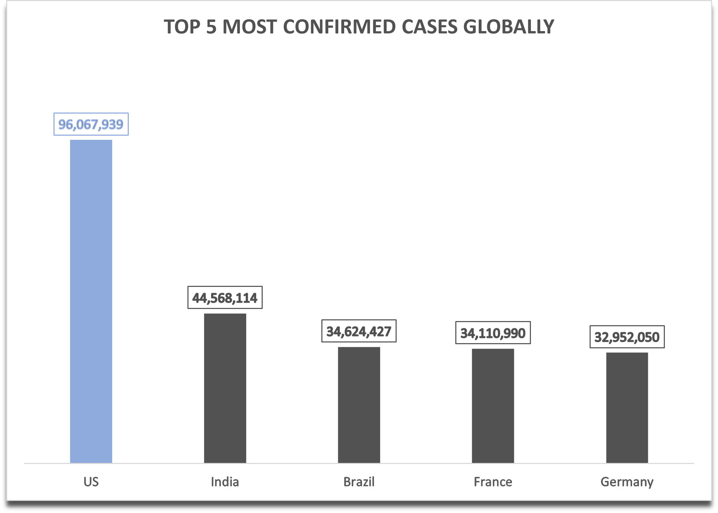
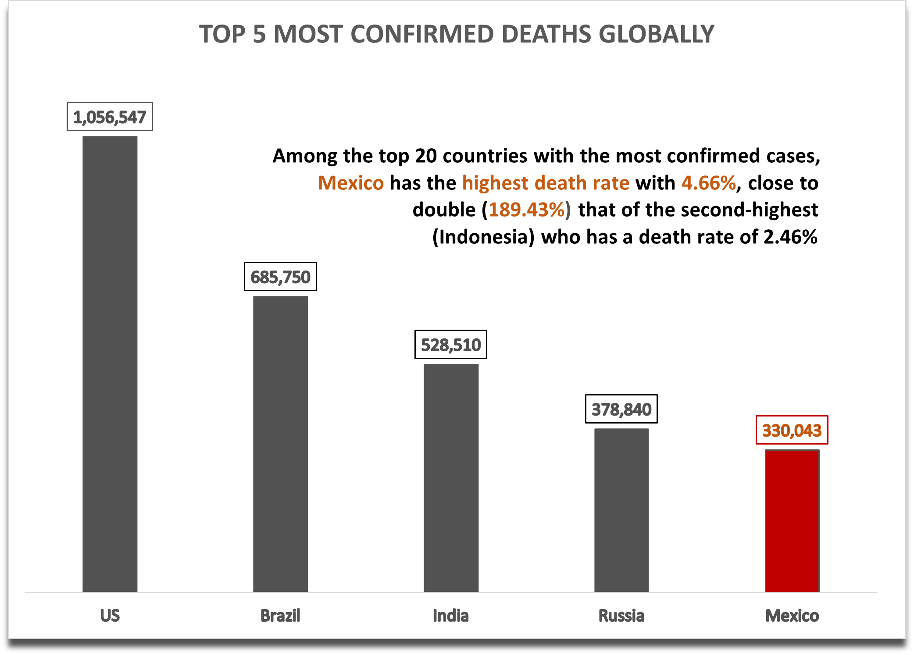
COVID-19 ACROSS THE GLOBE
- After quick analysis, I found out that, as at Sept 30, 2022, some 602,799,421 persons had been confirmed to have been infected with the virus, with the US being the country with the most confirmed cases; 96,067,939 confirmed cases, averaging a significant percentage of the total cases around the world (16%).
- On further analysis, I discovered that Mexico has the highest death rate from the confirmed cases; of every 100 people that got infected, 4-5 of them died from the virus (4.66% death rate). This is a large percentage based on the data as the country with the second-highest death rate, Singapore, has almost half of that value (2.46%). As there is no data to help assist us with understanding why these countries have such significantly high percentage compared to the global death rate (1.08%), we can only speculate as to what factors might be at play here.

Slide 7
THE FATALITY OF COVID-19
- Based on my findings after critical exploratory analysis, I discovered that the COVID-19 virus is not a death sentence as popular myths would have us assume it is with a global death rate of 1.08%; meaning if 100 people got infected from the virus, data has it that only 1 out of those 100 might die.
- Some countries have significantly higher death rates though (Mexico, Singapore, Brazil, to mention a few) ; exempting anomalies like that of North Korea that had only 1 confirmed COVID-19 case but 6 deaths due to the virus.

Slide 8
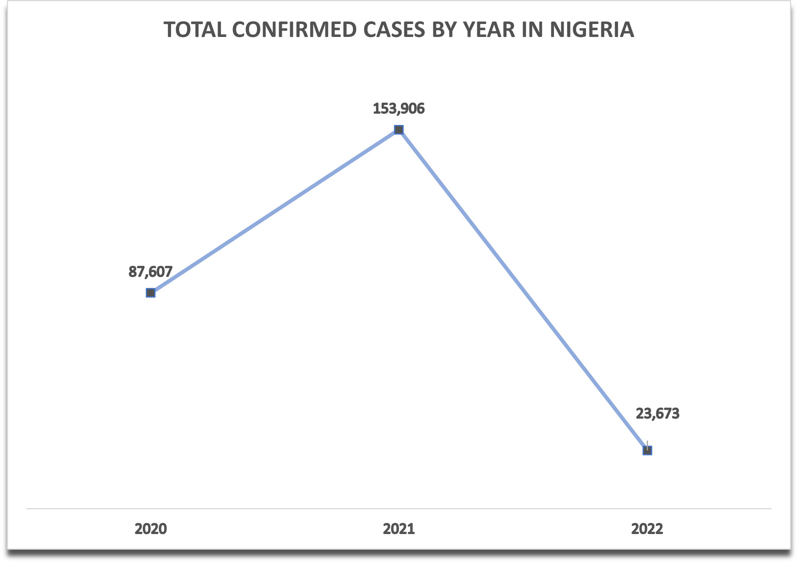
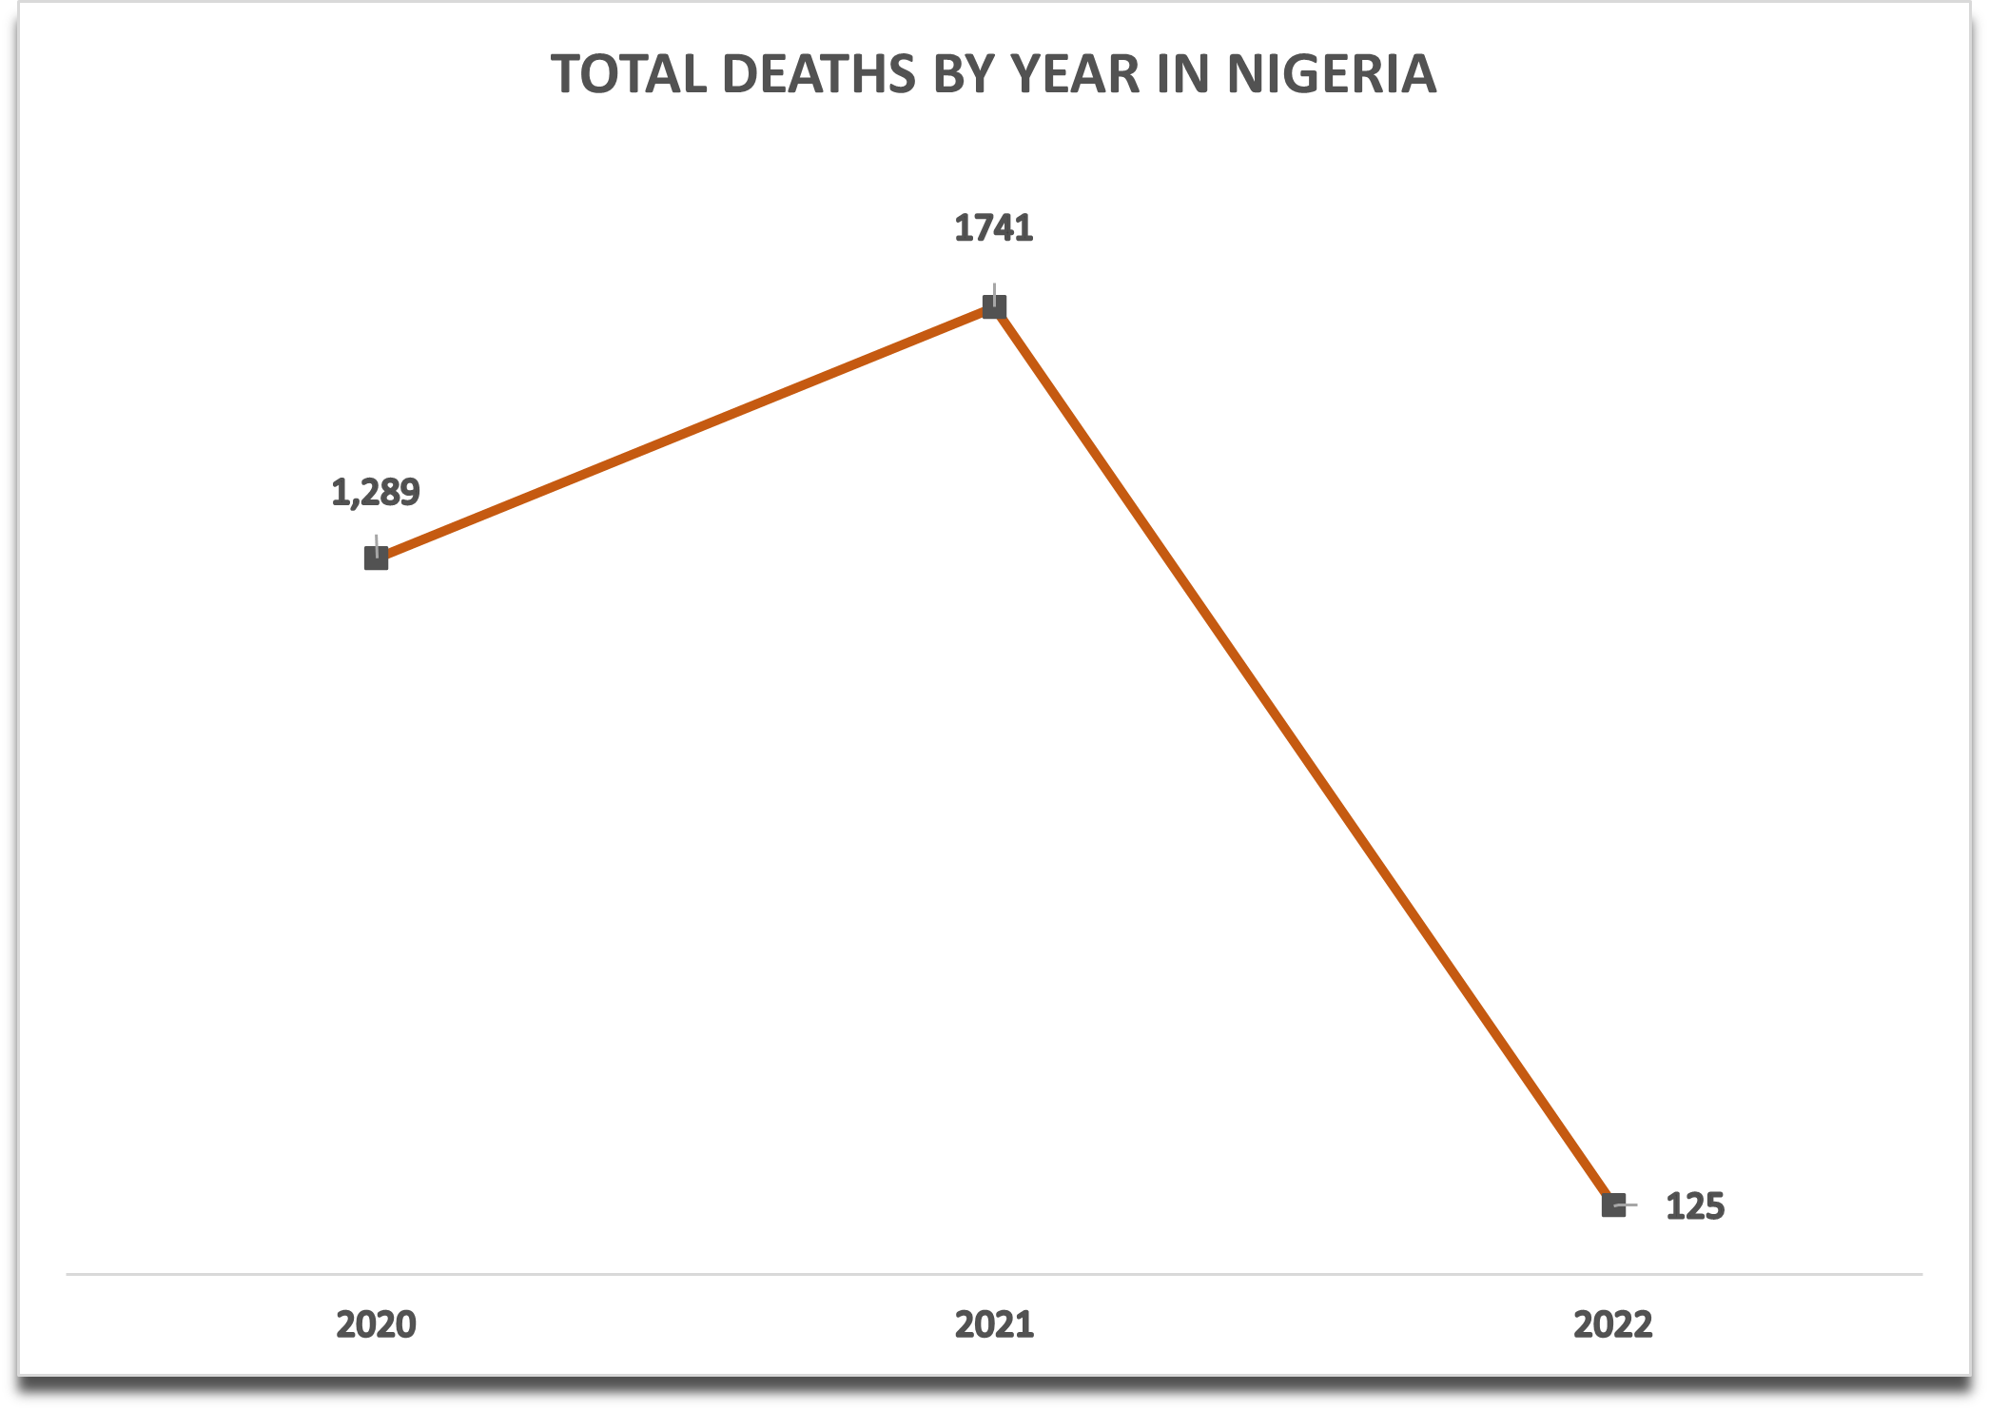
THE COVID-19 TREND IN NIGERIA
- According to the data, after a surge in the total number of confirmed cases and deaths caused by the virus from 2020 – 2021, we have noticed a significantly positive drop in those values, with less numbers in 2022 (23,673 confirmed cases and 125 confirmed deaths) than the year 2020 when we had 87,607 confirmed cases and 1,289 confirmed deaths caused by the virus .

Slide 9
CONCLUSION
- According to the data, the US is the epicentre of the COVID-19 virus.
- You are more likely to die of COVID-19 in Mexico than in other parts of the world.
- Getting infected with COVID-19 is not fatal.
- COVID-19 is quickly becoming a shadow of the past in Nigeria.

Slide 10
THANK YOU FOR YOUR TIME!

